Slide 1
Crisis Mapping: St. Himark 2019
Group 2: Charles devlen, sarah gothard, konain niaz, kenna pezzi
Notes:
Hello everyone, we are Group 2, and we will be presenting on our spatio-temporal analysis of a fictitious crisis surrounding nuclear contamination in the town of St. Himark. This work was based around the VAST 2019 challenge, as we will explain further later.

Slide 2
Presentation Agenda
St. Himark Earthquake: Radiation and Crisis Management
VAST Challenge Data Set(s)
Problem Description
Data Exploration
Visualizations and Analysis
Conclusions & Future Work
Notes:
Today, we will be walking through our analysis of the VAST Challenge dataset in five key sections.
First, we’ll give a brief overview of the VAST Challenge dataset itself.
Then, we’ll introduce the specific problems our group focused on solving.
Next, we’ll go into our initial data exploration—how we began to make sense of the dataset.
Following that, we’ll dive into our visualizations and analysis section. This section is broken into three parts: first, we examine uncertainty; then, we explore temporal patterns through time series and spatial analysis that show contamination evolving over time which will help us target evacuation and containment plans; and finally, we present animated visualizations.
We’ll wrap up with the conclusions we drew from our analysis and propose some ideas for future work.

Slide 3
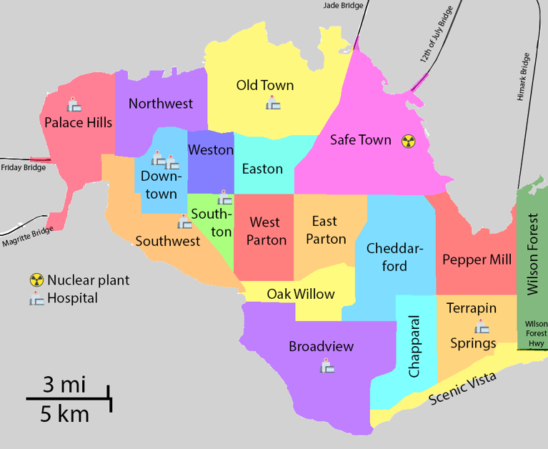
DATA SET: EARTHQUAKES AND DISASTERS
The VAST 2019 dataset was created around a fictitious disaster following an earthquake in the city of St. Himark
The data was collected over a period of 5 days, from April 6th to April 10th.
2 data sets:
Mobile Sensors (3,315,711 records): Citizen scientist sensors
Static Sensors (744,000): fixed place calibrated sensors
7 Original features (timestamp, sensor_id, longitude, latitude, radiation value, units, user_id)
Engineered features (Hours, Date, Weekday, Sensor Type [binary between mobile/static]
Shape file maps
Notes:
The VAST Challenge we selected for our project is the 2019 Mini-Challenge 2. It’s centered around a simulated natural disaster—a fictional earthquake that strikes the city of St. Himark.
The challenge provides us with a diverse and rich dataset collected over a five-day period, from April 6th to April 10th. It includes three main data files.
First, we have mobile sensor data—this contains over 3 million radiation readings from 50 sensors mounted on vehicles.
Second, there's a static sensor dataset, which includes around 700,000 observations from 9 fixed locations spread throughout the city.
Each dataset shares seven original variables. These include key information such as timestamps, longitude and latitude coordinates, and radiation measurements in counts per minute, or CPM.
Alongside the numerical data, the challenge also supplies visual assets—these include several maps in image format, both labeled and unlabeled.
Additionally, a shapefile of St. Himark's neighborhoods is provided, which contains polygon geometries defined in meters. These will be important for our spatial analysis later on.

Slide 4
PROBLEM DESCRIPTION:
After the earthquake, St. Himark’s emergency management team needs to better understand conditions throughout the city and identify areas to be monitored:
Address uncertainty in reports from the citizen scientists with mobile sensors
Report on model variation
Analyze conflicting reports/information through mean evaluation
Troubled area identification
Examine the spread of contamination over time
Determine which regions of the city need the most attention
Make plans for cleanup and evacuation
Create an animated map of St. Himark with radiation levels shown from mobile and fixed sensors over time
Notes:
After the earthquake, the emergency management team of St. Himark needed to be able to understand conditions throughout the city as well as identify areas to be monitored. In order to accomplish this, uncertainty in the reports from the citizen scientists needs to be identified so the emergency team has an accurate idea of conditions around the city
This involves reporting on model variation, as well as analyzing any conflicting reports or information
Trouble spots around the city need to be identified, which will involve determining the areas that need the most attention based on the radiation over time
Plans also need to be constructed for cleanup and evacuation of the city
This involves creating an animated map of St. Himark showing the radiation levels over time for both sensor types

Slide 5
Data Exploration
Descriptive Statistics Interesting Findings:
Sensor Labeling had 9 Overlapping names between Mobile Data Set and Static
There was 0 Intersection of Location (long/lat) between both data sets
Radiation Values Were Distinctly Higher for Mobile Sensor Reports than the Static Sensors
Mobile Sensor had 1 extreme outlier of a CPM value of 57,345.2 (user CitizenScientist) – removed for analysis
Table One
 | Mobile Sensor (n=3,315,711) | Static Sensor (n=744,000)
 | Mean(SD) | Mean(SD)
Longitude | -119.85(0.058) | -119.85 (0.056)
Latitude | 0.127 (0.048) | 0.145 (0.046)
Value | 45.98 (161.03) | 15.79 (11.88)
Hour | 11.14 (7.07) | 11.51 (6.93)
 | Unique Counts | Unique Counts
Sensor ID's | 50 | 9
Units | 1 | 1
User Id's | 22 | 1
Week Day | 5 | 5
Notes:
In our initial exploration of the datasets, we observed a few important characteristics.
First, we found that there are nine sensors that share the same names across the mobile and static datasets. However, despite the shared names, none of their GPS coordinates aligned—indicating that they represent different physical locations, even if they share identifiers.
Looking at radiation levels, we noted that mobile sensors consistently reported higher average values compared to the static sensors. This could be due to mobile sensors covering more contaminated zones or collecting readings in motion across different neighborhoods.
We also detected an extreme outlier in the mobile dataset—one reading close to 57,000 counts per minute. This value was an order of magnitude higher than the rest and was excluded from our subsequent analysis to maintain interpretability.
Geographically, we found that most of the data was concentrated around a longitude of approximately -119.85, suggesting a core area of activity or sensor movement.

Slide 6
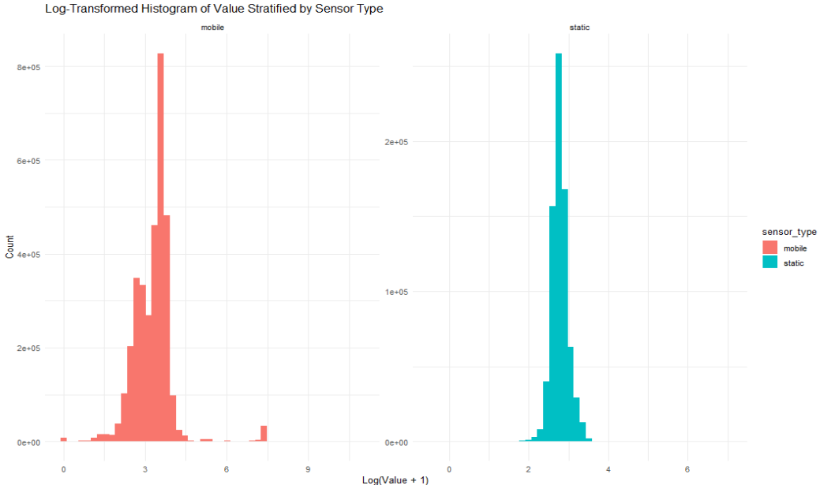
Data Exploration
VALUE Variable
Heavy untransformed skew to right (most values <500 mobile, <100 static)
Log transformation shows very narrow, tall distribution appearing approximately normal
Notes:
When we examined our primary response variable—radiation values measured in counts per minute—we found that the data was heavily right-skewed.
This skew is common in environmental or sensor data, where most values are low, but a few are extremely high.
To make the distribution more interpretable for visualization and statistical comparison, we applied a logarithmic transformation to the values.
After the transformation, both mobile and static sensor readings showed narrow, approximately normal distributions, as you can see in the histogram. This helped us better understand the central tendency and spread of the data without the distortion caused by extreme values.

Slide 7
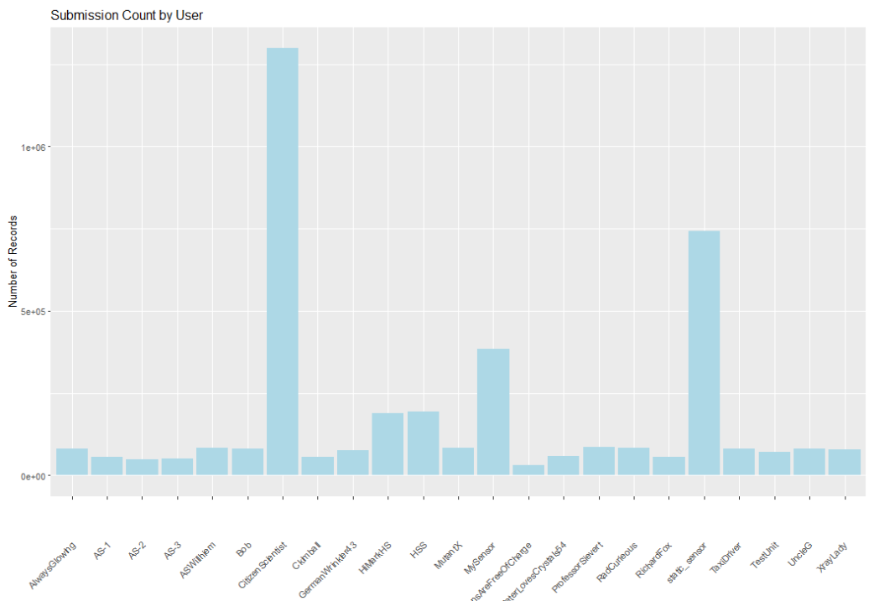
Data Exploration
User Counts
Citizen Scientist was overly represented in the count distribution of the mobile users.
Notes:
During our analysis of the mobile sensor data, we looked into which users were contributing the most readings.
We quickly discovered that one user, identified as Citizen Scientist, was responsible for a disproportionately large number of the total mobile sensor reports.
This kind of skewed user representation has important implications—it could introduce bias in the spatial and temporal distribution of the data, especially if this user's movement patterns dominate the dataset.

Slide 8
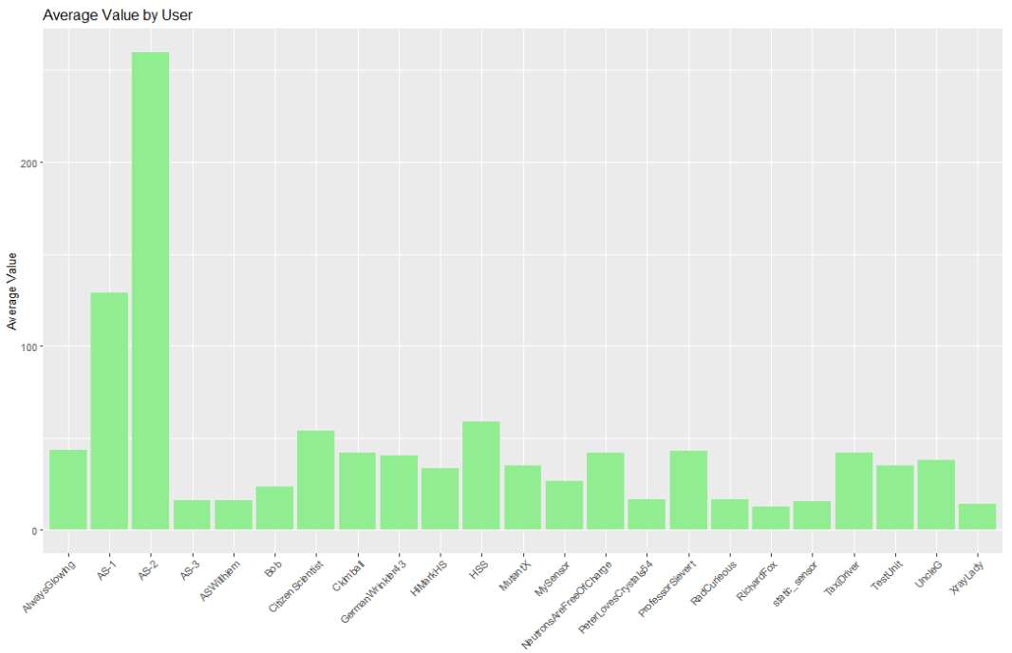
Data Exploration
User Averages
Citizen Scientist was overly represented in the count but AS-2 reported the highest average values
Notes:
While Citizen Scientist was by far the most active in terms of the number of readings submitted, we found something interesting when we shifted our focus to average radiation levels reported by each user.
As shown in this chart, the user labeled AS-2 recorded significantly higher average CPM values than any other user—including Citizen Scientist.
This finding suggests that while Citizen Scientist covered a wide area or had more exposure time, AS-2 may have operated in a more contaminated zone or had a sensor calibrated differently.
It highlights the importance of not just looking at quantity of data, but also at the intensity of readings when assessing sensor or user behavior.

Slide 9
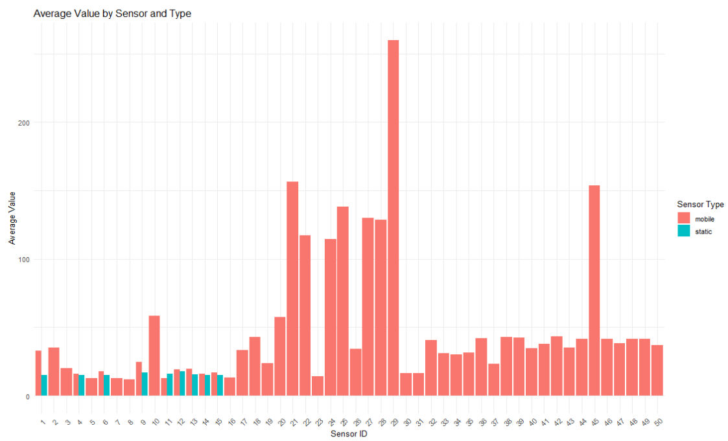
Data Exploration
Average Values By Sensor
Sensors from Mobile User’s reported high CPM values
Notes:
This visualization compares the average radiation values reported by mobile versus static sensors.
As you can see, mobile sensors consistently recorded higher average CPM levels. This isn’t entirely surprising given their dynamic nature—they likely passed through more contaminated areas, especially in the aftermath of the disaster scenario.

Slide 10
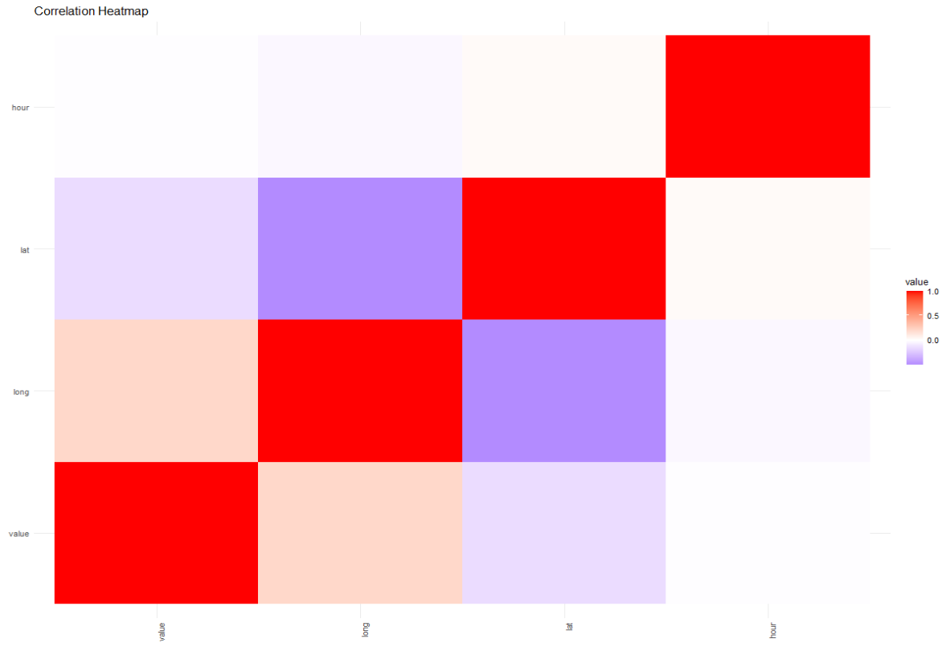
Data Exploration
Correlation
For aggregate data, there was a moderate correlation between longitude and the value of radiation
Notes:
A correlation heatmap of aggregated data showed that value and longitude were mildly to moderately correlated

Slide 11
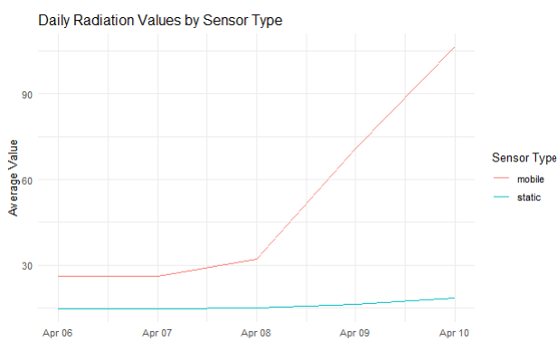
Visualization and Analysis: Uncertainty [Mean]
Parametric T.test (p.value = 0.08) found moderate but non-significant signaling of a difference between daily averages of mobile and static sensors
Non-parametric Wilcoxon Rank-Sum T.test (p.value=0.008) found significant difference between the daily averages between mobile sensor reports and static sensor reports
Notes:
As we began our deeper analysis, we first looked at uncertainty in the data by comparing changes in mean and standard deviation of radiation values over time.
We made the key assumption that the static sensors serve as our ground truth—they’re stationary, professionally maintained, and likely to be more consistent and reliable than mobile devices.
When plotting daily average radiation levels, we noticed a clear trend: both sensor types showed increases at similar time points, but the mobile users exhibited a much steeper rise, particularly in the final days of the data collection period.
A basic parametric t-test suggested a difference in mean values, but the results weren’t statistically significant. However, a non-parametric Wilcoxon test, which is more appropriate given the skew and variability in our data, did find significant evidence that mobile users consistently reported higher daily radiation values.
This supports our earlier findings and is consistent with the expectation that mobile sensors encountered a broader range of conditions

Slide 12
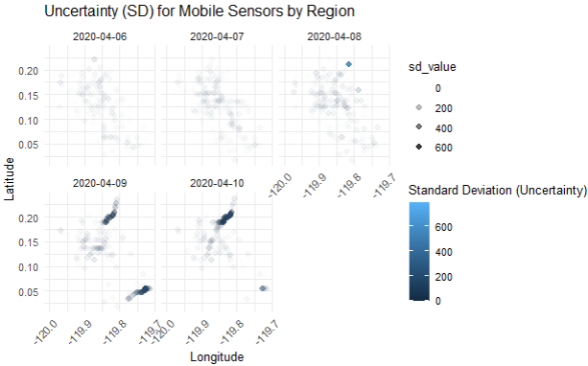
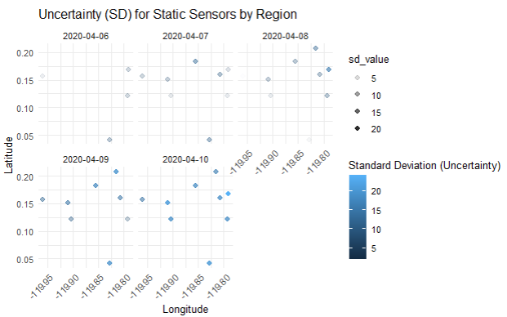
Visualization and Analysis: Uncertainty [SD]
Concentrations of Variance where in relatively the same geographical locations between mobile and static sensor reports
Notes:
Our second approach to analyzing uncertainty focused on standard deviation, measured over time, and how it varies spatially between mobile users and static sensors.
This slide shows faceted scatter plots that compare the two sensor types—mobile on one side and static on the other—across different geographic coordinates.
What we found was interesting: although the mobile sensors are dynamic and move through the environment, and the static sensors remain fixed, the standard variation in radiation readings tended to cluster in similar longitude and latitude ranges across both datasets.
This suggests that certain areas within St. Himark exhibited consistently high or unstable radiation patterns, regardless of the method of measurement. It strengthens the case for spatially anchored anomalies or persistent environmental conditions affecting sensor output.

Slide 13
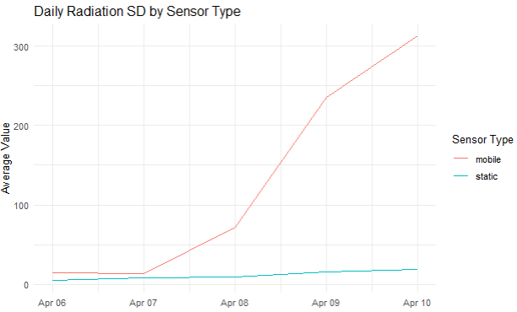
Visualization and Analysis: Uncertainty [SD]
Standard Variation had significant change on Wednesday for mobile users, but static sensors so nominal changes in variation.
Notes:
Continuing our analysis of uncertainty, we looked at how standard deviation in radiation readings changed over time.
This line graph shows the daily standard deviation for both mobile and static sensors.
We found that standard variation increased gradually for both sensor types—but more dramatically for mobile users starting on April 8th.
This spike in variation likely reflects growing environmental instability or increased exposure as mobile users traversed more contaminated zones.
The trend supports our earlier findings: mobile sensors not only report higher average values but also experience greater variability, which may point to their coverage of more dynamic or hazardous environments.

Slide 14
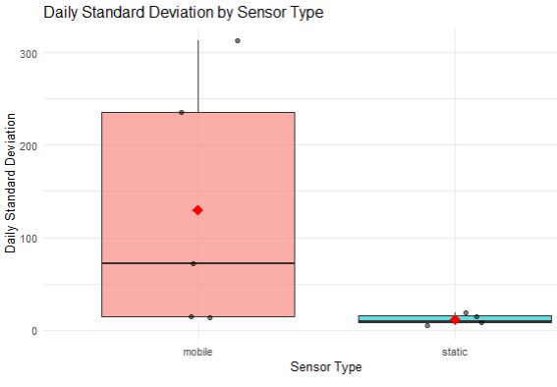
Visualization and Analysis: Uncertainty [SD]
Neither parametric T.test (p.value = 0.12) or Non-parametric Welch T.test (0.095) found significant difference between the daily variation between mobile sensor reports and static sensor reports
Descriptively, more variability (mobile group sd average~130, static group sd average~11)
Notes:
To wrap up our analysis of standard deviation, we conducted hypothesis testing to compare daily variability between mobile and static sensors.
First, you can see the box plot here, which shows the distribution of daily standard deviations for both sensor types. As expected, mobile sensors show much higher variability—around 130 counts per minute compared to just 11 for static sensors.
However, when we ran both parametric and non-parametric tests, the results were not statistically significant, with the p-values of 0.12 and 0.095 respectively, thus we cannot confidently say that the difference we observed is not due to chance.
Descriptively, the difference in variability is large and makes sense—mobile sensors are exposed to more dynamic conditions, including noise and varying radiation sources due to their movement. However, from a statistical standpoint, the sample size and variance within the groups make it difficult to conclusively determine that this difference is meaningful without further data or improved modeling.

Slide 15
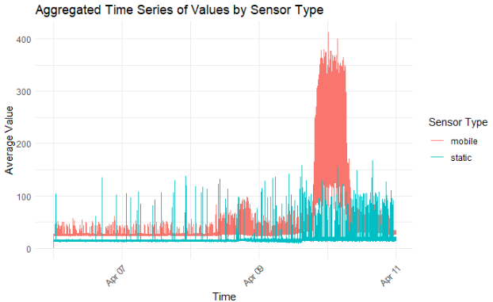
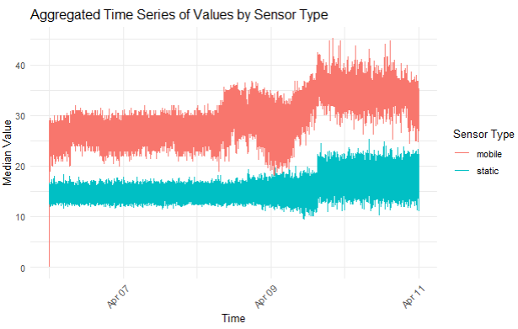
Visualization and Analysis: Troubled Area [Time]
Notes:
Our second focus was on time series analysis to observe how radiation contamination levels evolved over the days.
We began by looking at the daily averages for both mobile and static sensors. As expected, static sensors showed more consistent daily averages—likely due to their fixed, calibrated locations. However, the presence of large outliers in the dataset, even after removing the largest one, means these averages may be skewed at times.
Next, we turned to median values to better handle the influence of extreme outliers. When examining the median radiation values, we found that mobile sensors consistently reported higher median radiation levels over time, despite showing less variation in extreme highs and lows. This suggests that while mobile sensors encountered more fluctuating environments, they still tended to report higher contamination levels on average.
Interestingly, when you look at both graphs, the mobile sensor lines show a more consistent upward slope compared to static sensors. This indicates a trend of increasing contamination exposure for mobile sensors over time, while static sensors had a shallower increase of radiations exposure.

Slide 16
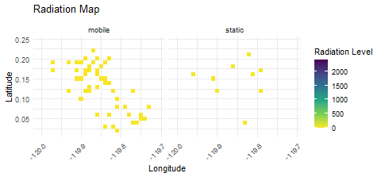
Visualization and Analysis: Troubled Area
Notes:
As expected, mobile users saw a lot more movement in location, and their coverage across the area varied in radiation concentration.

Slide 17
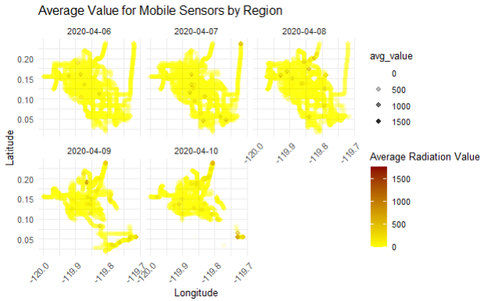
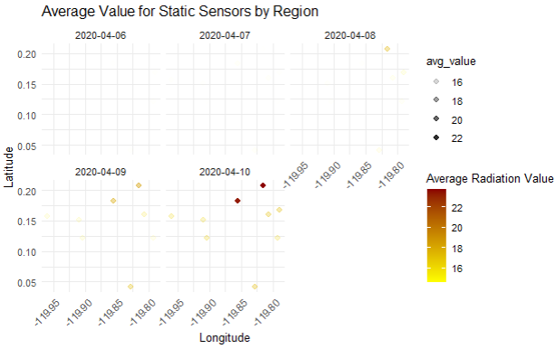
Visualization and Analysis: Troubled Area
Notes:
Continuing our troubled area analysis we observed that troubled areas for mobile sensors were consistently concentrated around longitude –119.86 and latitude 0.18, with values increasing over time in this region. Similarly, sensor data showed a growing concentration in this same coordinate space as time progressed.

Slide 18
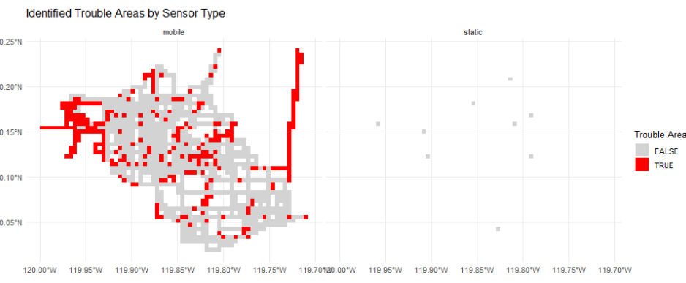
Visualization and Analysis: Troubled Area
The TRUE/FALSE values in the trouble_area column represent whether each grid cell exceeds the defined threshold (e.g., the 75th percentile of mean_value)
Notes:
In more granular troubled area analysis, we applied a threshold to identify troubled regions. We defined this threshold as locations falling in the top 25% of values—specifically, those above the 75th percentile of the mean radiation values. This statistical approach was used because we lacked baseline or "safe" levels to compare against.
Using this method, we observed that troubled areas for mobile sensors had two areas of distinct concentrations: one of them around longitude –119.95 and latitude 0.15 and another around longitude-119.70 which had a wider lateral spread. This thresholding found no static sensor data that broached the 75th percentile reading, due to the much lower readings overall from these units.

Slide 19
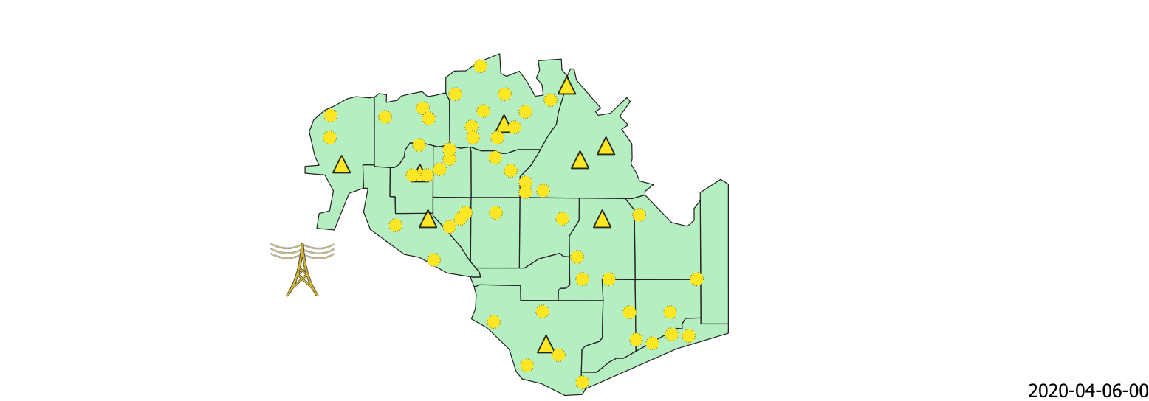


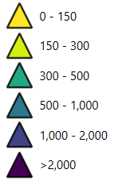
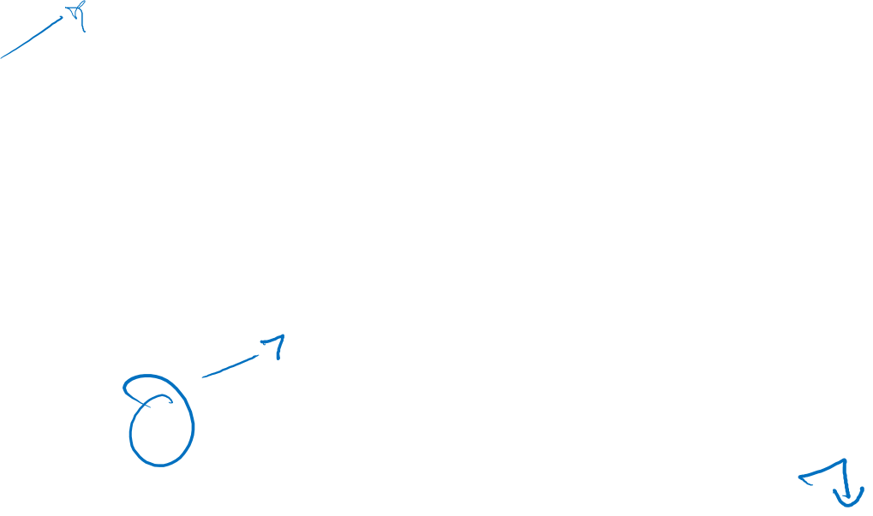
Data Visualization and Analysis: Animation
The following is the animation shows Static (triangle) and Mobile (circle) sensor readings from April 6th to 10th.
Hospitals
Nuclear Plant
Notes:
Since there were more than 4 million readings from all sensors. For a comprehensible animation, we rounded each reading to the nearest 5 CPM. Then we binned all readings into the same hour. Since the mobile sensors were taking multiple readings at the same location, we aggregated those for the most commonly occurring value at that specific longitude and lat. So the mode. For the static sensors, we took the modal reading for each hour. The time interval on the bottom right here is a step frame of 1 hour.
As you can see here, the mobile sensors never go above 150.
The mobile readings also mostly stay below 150. With a few exceptions going above 300. First time observed are on the 8th. This is consistent with our previous value trends.
After which this 1 sensor reads between 1,000 and 2,000 for 4 consecutive hours on the same day, collected by HSS.
This should be a point of interest considering these are the modal values for each hour.
Then on the 9th, many multiple sensors in Jade Bride and Terrapin Springs read between 300 and 500. With one sensor reading above 1,000. Consistent with our average reading hotspots.
Interestingly a sensor in Wilson forest reads above 1,000 for 13 continuous hours. This is either a big point of alarm or a faulty reading. To further investigate Let’s dive into another animation with another metric that may help us investigate better.

Slide 20
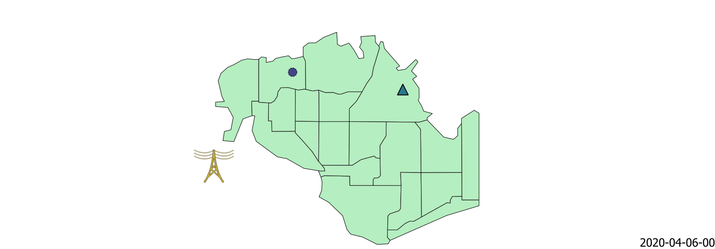

Data Visualization and Analysis: Animation
The following is the animation shows Static (triangle) and Mobile (circle) sensor readings from April 6th to 10th. Radiations above 150 CPM [1]
Hospitals
Nuclear Plant
1. U.S. Department of Health and Human Services. (2020). Comparison of radiation population screening recommendations from ROSS Toolkit on the RadResponder.net website. Radiation Emergency Medical Management (REMM). https://remm.hhs.gov/Radiation-Screening-Recommendations-from-RadResponder1.pdf
Notes:
After using the same initial data cleaning as before , where we rounded each reading to the nearest 5 CPM and binned all readings into the same hour.
HERE we split the dataset to readings above 150 CPM, which is considered a very dangerous level of radiation by the Radiation Emergency Medical Management. This gave us about 51,000 mobile sensor readings and 300 static sensor readings. In the animation here, the readings are aggregated, meaning we have new readings on top of the old readings – all visible.
Initially, we see mobile readings mostly less b/w 500 and 1,000 CPM. And none of the static readings higher than 500.
In day 2, we start to see more mobile readings below 300, and the first static reading above 1,000. So, an inverse trend b/w both sensors for the first two days.
The first mobile reading above 2,000 is observed on the evening of the 8th. Previously we saw the average values increase over time, which is consistent here. However, an interesting trend to note with all values over 150 is that initially, most mobile readings observe 1,000 CPM, but as days progress, they observe mostly between 150 – 500. With a few (36 to be exact) reading above 2,000.
Alternatively, the static readings never go above 2,000. And they mostly stay within 500 to 1,000 CPM. There is really no trend to observe here since each static sensor oscillates between 0 – 1500. With the maximum static reading being 1,165. An important caveat for static sensors is that that these are just 300 out of 744,000 total readings.

Slide 21

Conclusion: Mobile vs. Static Readings
Daily averages between mobile and static readings differed significantly with appropriate testing.
Fixed sensors were calibrated and stationary, giving consistent, reliable readings
Mobile sensors varied in build quality and calibration, leading to inconsistent data
Vehicle-based sensors were affected by contamination and shielding
Some cars were directly contaminated, falsely elevating radiation readings
Movement and human error introduced additional noise and uncertainty
Notes:
One of the major challenges in analyzing the radiation data was understanding why mobile and fixed sensors showed different results. The fixed sensors were calibrated and professionally installed in stable locations, so they gave us a consistent baseline.
In contrast, mobile sensors were built and deployed by citizen scientists, so they varied widely in accuracy. Because they were mounted on cars, they were also affected by shielding from the vehicle body, and in some cases, direct contamination, especially for cars near the plant during the quake. Some sensors recorded unusually high spikes due to this.
Plus, the movement of the cars and variability in how the sensors were handled introduced even more noise. So, while the mobile data helped fill in spatial gaps, it came with much more uncertainty than the fixed network.

Slide 22
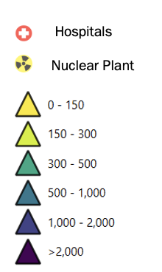
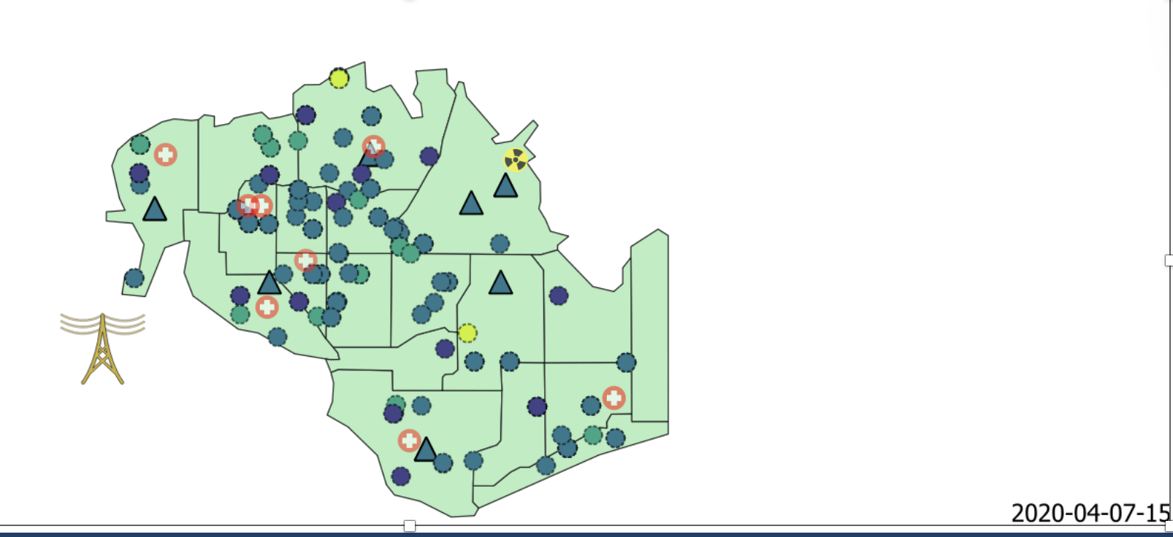
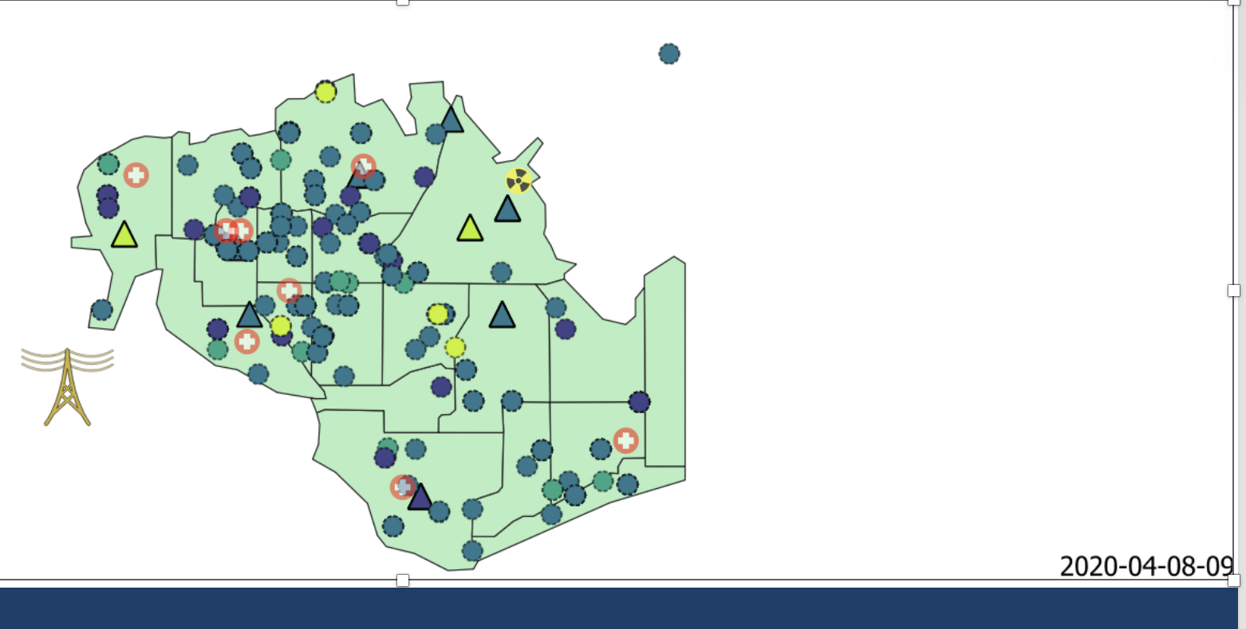
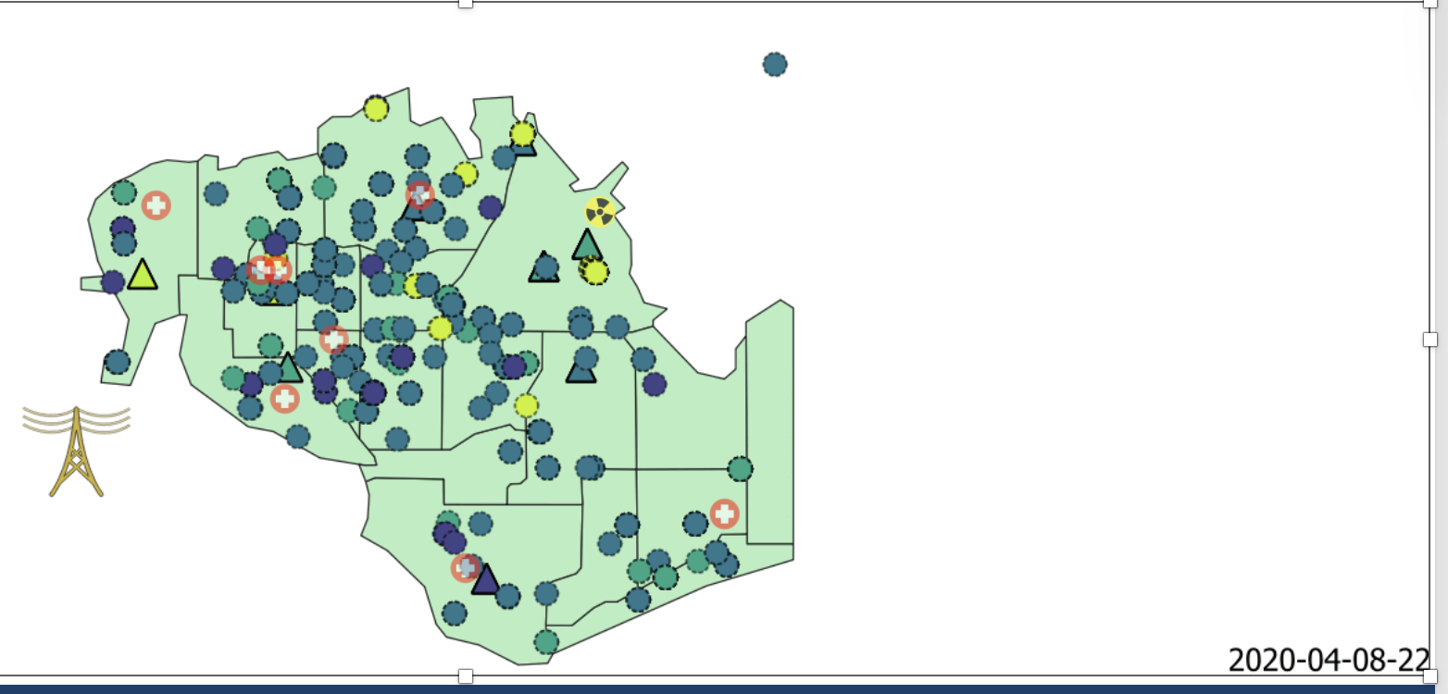
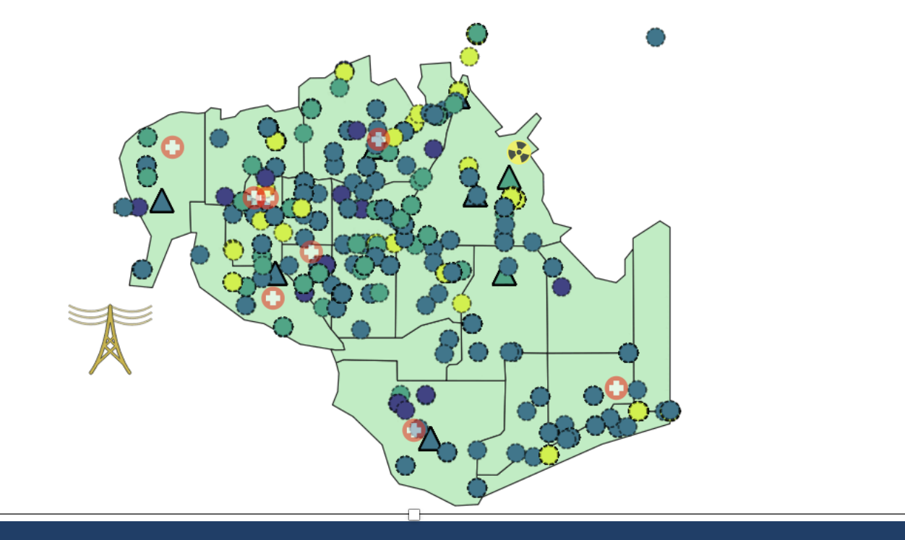
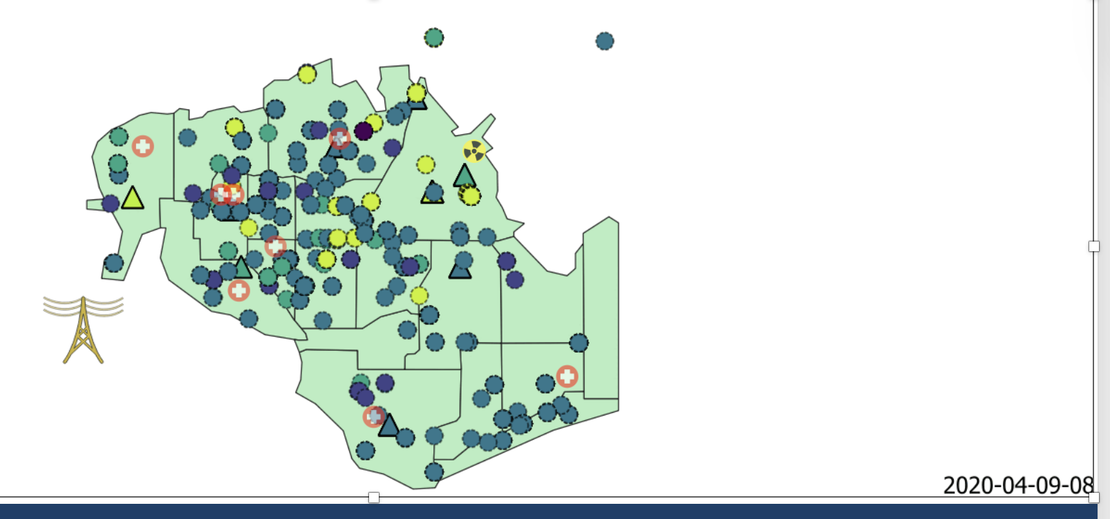
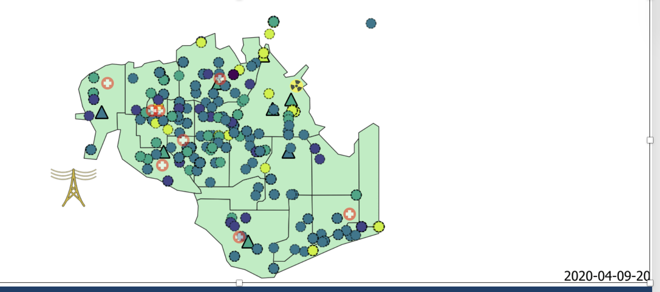
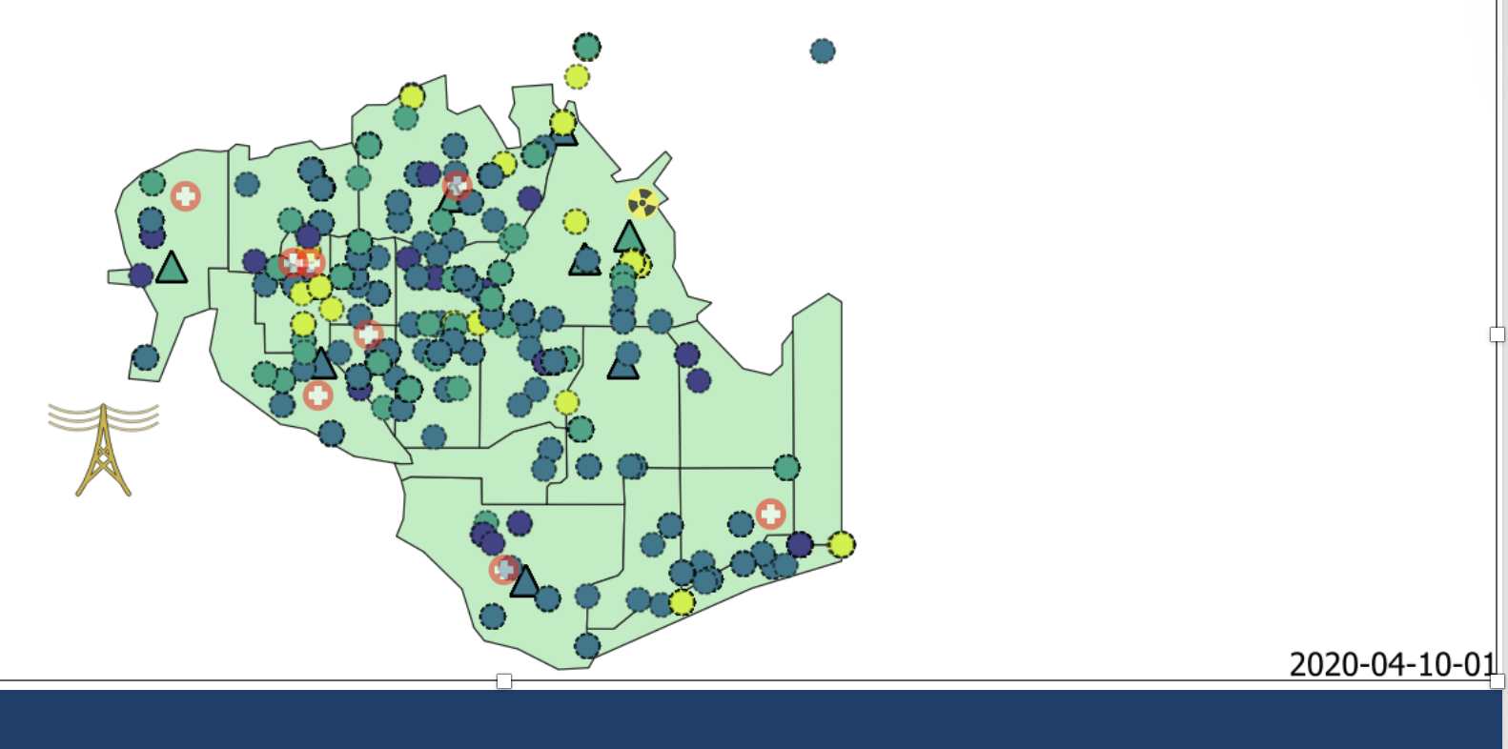
Conclusion: Plans for Cleanup
4/7: 3 PM
4/8: 9 AM
4/8: 10 PM
4/10: 10 PM
4/9: 8 PM
4/10: 1 AM
4/9: 8 AM
Notes:
First, we will use the animation of radiation over time to visualize areas to focus on for cleanup.
Early on, we see moderate contamination mostly near the nuclear plant, but by April 8th and 9th, higher concentrations begin to appear farther west and south, especially near major roads and hospitals.
By April 10th, we observe persistent hotspots in several key areas: around the nuclear plant, Downtown, along Wilson Highway and near and on Jade Bridge where several contaminated vehicles likely spread radiation as they traveled.

Slide 23
Conclusion: Plans for Cleanup
Consistent high contamination found near Jade Bridge and Old Town Hospital across both sensor types
Mobile sensors reveal additional high radiation near Wilson Forest Hwy, not detected by static sensors
Mobile network adds spatial insight, despite higher uncertainty
Mobile sensor readings
Static sensor readings
Notes:
We can also use our troubled area analysis, which identifies areas with average radiation above the 75th percentile. This method of analysis is useful because we didn’t have an official contamination safety baseline. It also helps us identify the most critical cleanup areas by comparing both mobile and static sensor data.
First, both networks consistently showed high radiation near Jade Bridge and the Old Town Hospital, which validates those as clear priorities for remediation.
However, the mobile sensors revealed an additional hotspot near Wilson Forest Highway—likely due to contaminated vehicles moving through the area. This area wasn’t flagged by the fixed sensors, highlighting how mobile sensors, despite their uncertainty, are essential for capturing the full picture.
So, to summarize: Jade Bridge, Old Town, and Wilson Forest Hwy are our top targets for cleanup, based on both statistical and visual analysis.

Slide 24
Conclusion: Plans for Cleanup
Notes:
To summarie both methods of analysis our priority cleanup areas should include:
The plant itself and its immediate surroundings in Safe Town
The hospital zones, especially Old Town and Downtown
Major transit routes where contamination was mobile, like Jade bridge and Wilson forest highway
These areas consistently show elevated radiation and pose the greatest risk to public health if not addressed

Slide 25
Future Work
Spatial pairing of sensor data not performed; no direct location matches between mobile and static sensors
Future analysis could use:
Clustering to group readings by geographic zones
Nearest point analysis to compare static and mobile readings in proximity
Incorporate baseline/background radiation levels for better thresholding
Add temporal clustering to detect persistent vs. transient radiation patterns
Consider sensor confidence scoring to account for device reliability
Notes:
For this analysis, we didn’t perform direct comparisons between mobile and static sensors at the same locations—mostly because the two data sets didn’t have any overlapping coordinates.
To improve this, future work could use clustering by general area or apply nearest point analysis to make more meaningful comparisons between the sensor types. This would help us understand how well the mobile data aligns with the fixed network across the city.
We’d also benefit from incorporating a true background radiation baseline, which would make our thresholding more precise.
Lastly, using temporal clustering and confidence scores for each sensor could help separate short-term anomalies from longer-term contamination zones, especially given the noise in the mobile data.

